Slide 1

Introduction to Reinforcement Learning
Hongning Wang
CS@THU

Slide 2
Outline
What is reinforcement learning?
Why do we need it?
How to?

Slide 3
Reinforcement learning
Reinforcement learning (RL) is an area of machine learning concerned with how software agents ought to take actions in an environment in order to maximize the notion of cumulative reward.
- Wikipedia
Reinforcement learning is learning what to do — how to map situations to actions — so as to maximize a numerical reward signal.
- Sutton & Barto, 2018

Slide 4
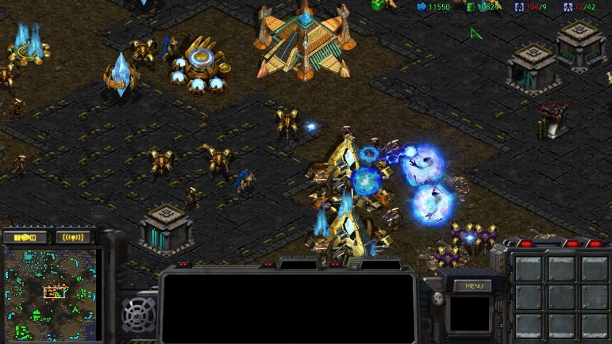
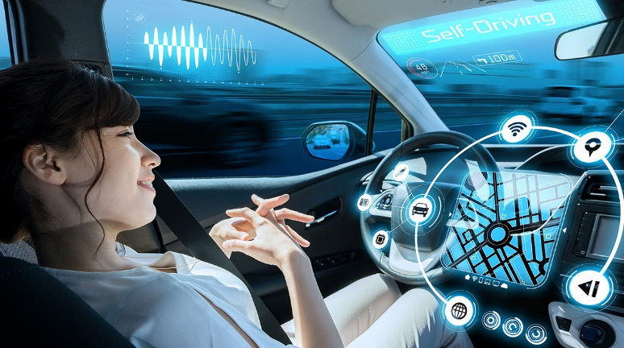

Reinforcement learning
It is a family of problems
  Sequential decision making
Game playing
Self-driving car
Conversational system

Slide 5
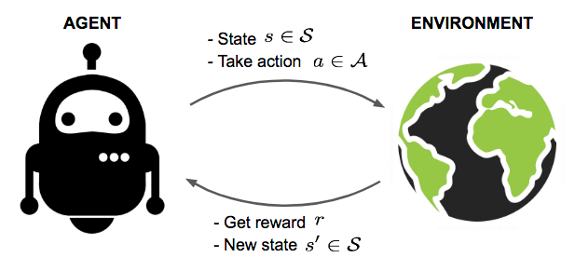
Reinforcement learning
A typical (narrow) view of the problem formulation
Markov decision process, to be covered
Image credit: Lil'Log

Slide 6
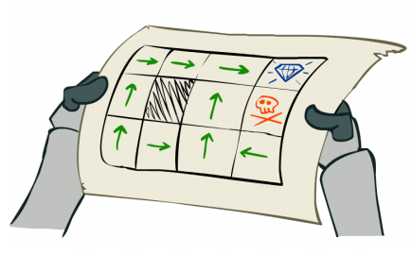
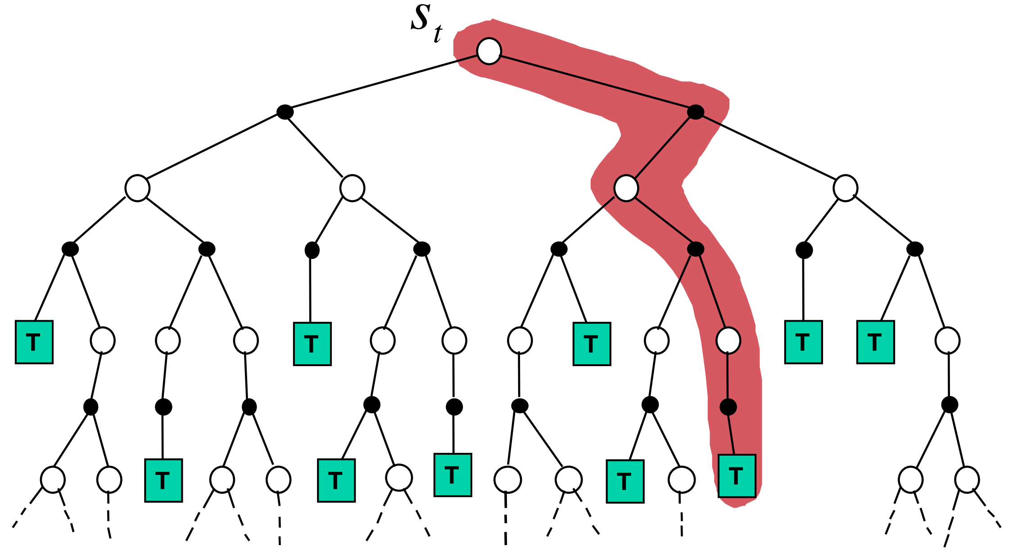
Reinforcement learning
It is a family of solutions
  Taking a series of actions to maximize cumulative return
Planning
Planning while learning
Reinforcement
Image credit: David Silver, “Model-Free Prediction”

Slide 7
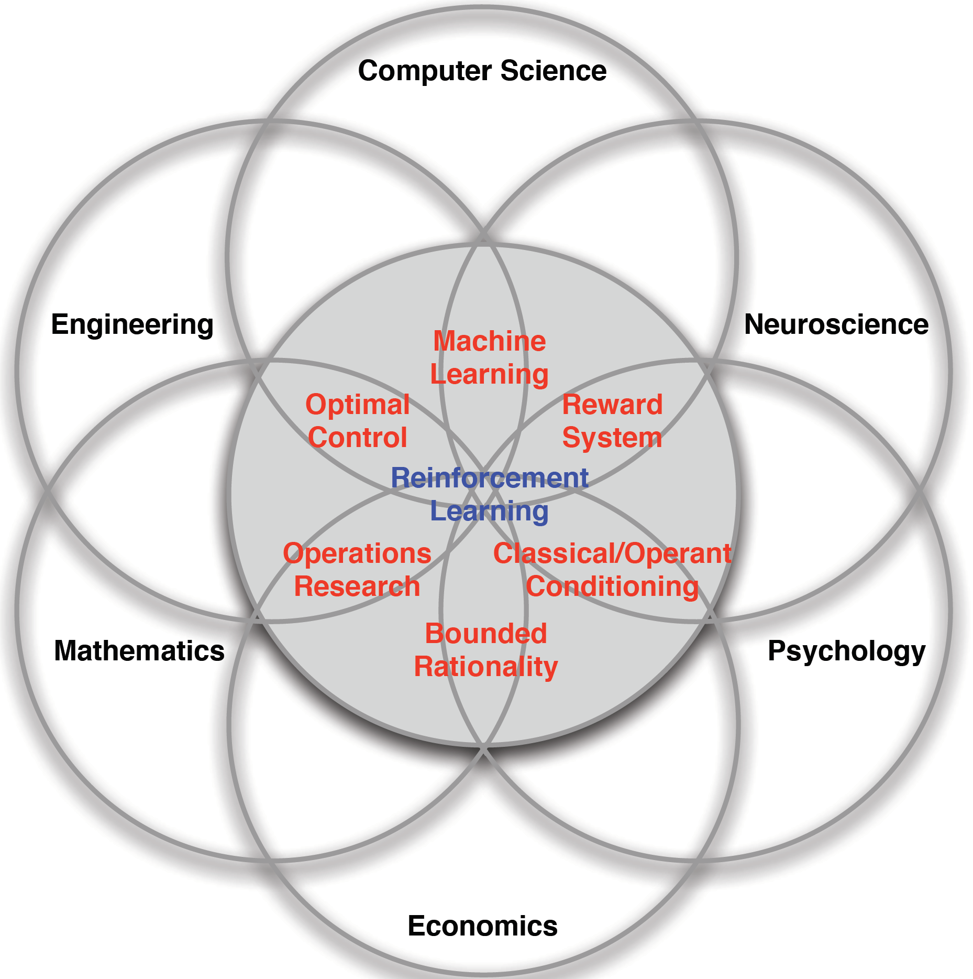
Reinforcement learning
It is a collection of fields that study such problems and solutions
  Computer science, psychology, neuroscience, optimization, operational research, and many others
Figure credit: David Silver, “Introduction to RL”

Slide 8
Summary: reinforcement learning
It is a family of problems
  Sequential decision making
It is a family of solutions
  Planning and learning
It is a collection of fields that study the problems and solutions

Slide 9
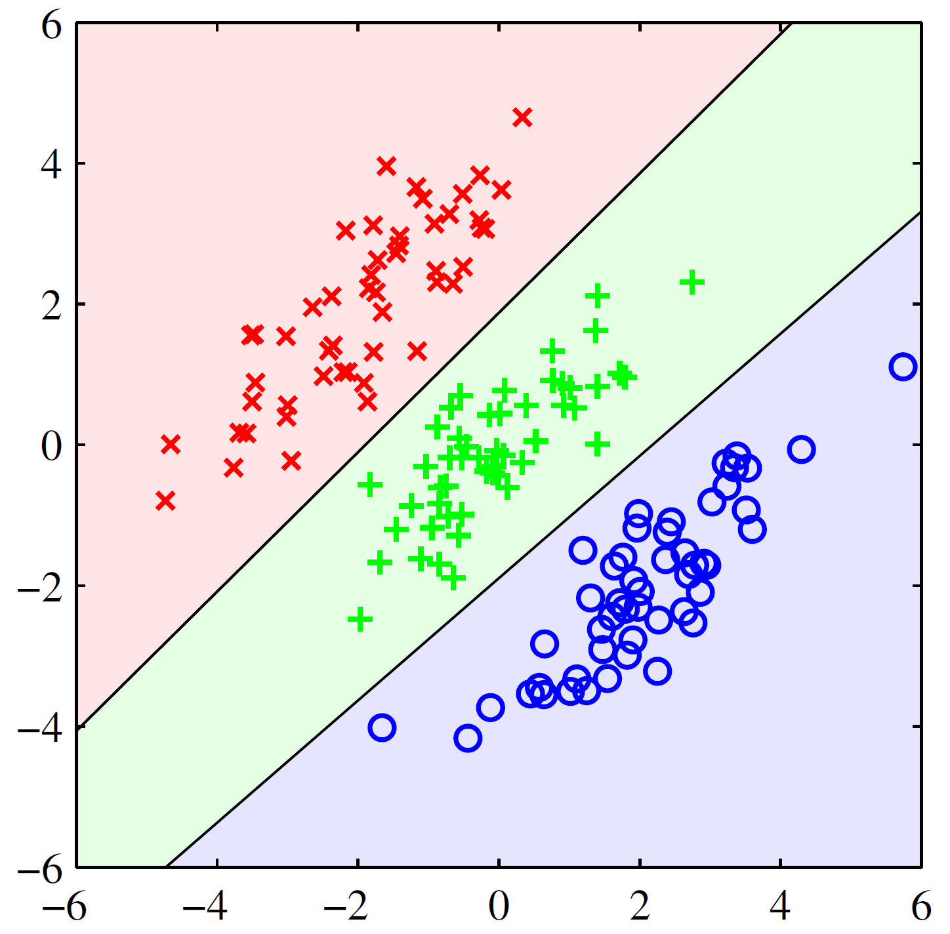

Vs. Supervised machine learning
Classification as an example
  Training time
    Input: ${\{\left(x_{n},y_{n}\right)\}}_{n=1}^{N}$, where $x_{n}∈R^{d}$ and $y_{n}∈[C]$
    Output: hypothesis $f_{θ}\left(x\right)→y$
    Goal: $\min_{θ∈Θ}{\sum_{n=1}^{N}{L(f_{θ}\left(x_{n}\right),y_{n})}}$
  Testing time
    Apply $f_{θ}\left(x\right)→y$
Do we really have a choice here?
The only decision(s) to make
Are we making any decisions here?
Image credit: Bishop, “Pattern Recognition and Machine Learning”

Slide 10











Vs. Supervised machine learning
Do we really have a choice here?
Online classification as an example
  The hypothesis will be immediately tested
    Input: ${\{\left(x_{t},y_{t}\right)\}}_{t=1}^{T}$, where $x_{t}∈R^{d}$ and $y_{t}∈[C]$ arrive sequentially
    Output: hypothesis $f_{θ_{t} }\left(x\right)→y$ and $\hat{y}$
    Goal: $\sum_{t=1}^{T−1}{\min_{θ_{t}∈Θ}L(f_{θ_{t}}\left(x_{t+1}\right),y_{n+1})}$
Cumulated over T
Observe $y_{t}$ & update $f_{θ_{t}}$
$$y_{1}:θ_{1}=argmin_{θ∈Θ}L({\hat{y}}_{1},y_{1})$$
Now are we making sequential decisions to optimize some cumulative metric?
Predict ${\hat{y}}_{t}$
$$f_{θ_{0} }\left(x_{1}\right)→{\hat{y}}_{1}$$
$$f_{θ_{1} }\left(x_{2}\right)→{\hat{y}}_{2}$$
……
Observe $x_{t}$
$$x_{1}$$
$$x_{2}$$
1
$$t$$
$$T$$

Slide 11
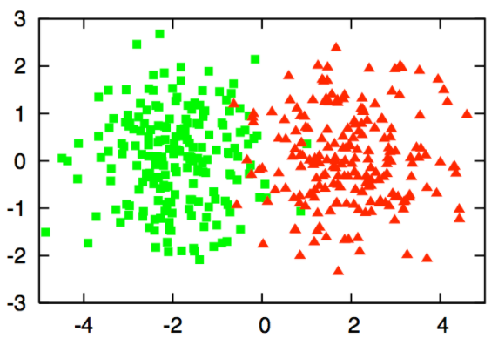
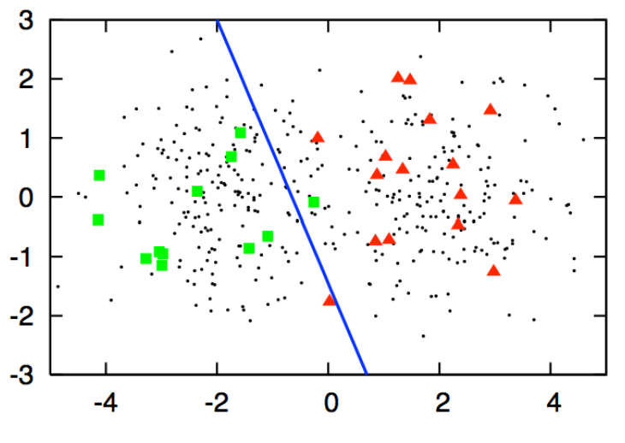






Vs. Semi-supervised machine learning
Active learning for classification as an example
  Training time
    Input: ${\{x_{n}\}}_{n=1}^{N}$, where $x∈R^{d}$
    Procedure: choose a subset of instances of size $T$ to obtain their labels for model training
    Output: hypothesis $f_{θ_{T} }\left(x\right)→y$
    Goal: $\min{E_{P(x,y)}[L\left(f_{θ_{T}}\left(x\right),y\right)]}$
  Testing time
    Apply $f_{θ_{T}}\left(x\right)→y$
This makes us only need to explore!
$$t=1$$
Budget: $T$ queries
$$t=4$$
$$t=2$$
Now our decisions affect our observations, right!?
$$t=3$$

Slide 12






Full v.s., partial information
Full information – in most supervised ML
  $\left(x_{t},y_{t}\right)$ is always given
Partial information - bandit feedback
  Only $L\left(f_{θ}(x_{t}),y_{t}\right)$ is provided
${\hat{y}}_{t}$=Bear
($x_{t}$, $y_{t}$=Dog)
$$x_{t}$$

Slide 13


















Exploitation v.s., exploration
Unknown unknowns
Horror
Romance
Drama
Figure credit: Schnabel et al. 2016 ^{[SSSCJ16]}
Matthew effect: we still don’t know what we don’t know!

Slide 14
A quick summary
Reinforcement learning
  Reward
  Partial information
  Delayed consequence
  Agent’s choice affects the subsequent data it receives, i.e., non-i.i.d.
Supervised machine learning
  Ground-truth labels
  Full information
  Immediate consequence
  Pre-determined data distribution, i.e., i.i.d.

Slide 15
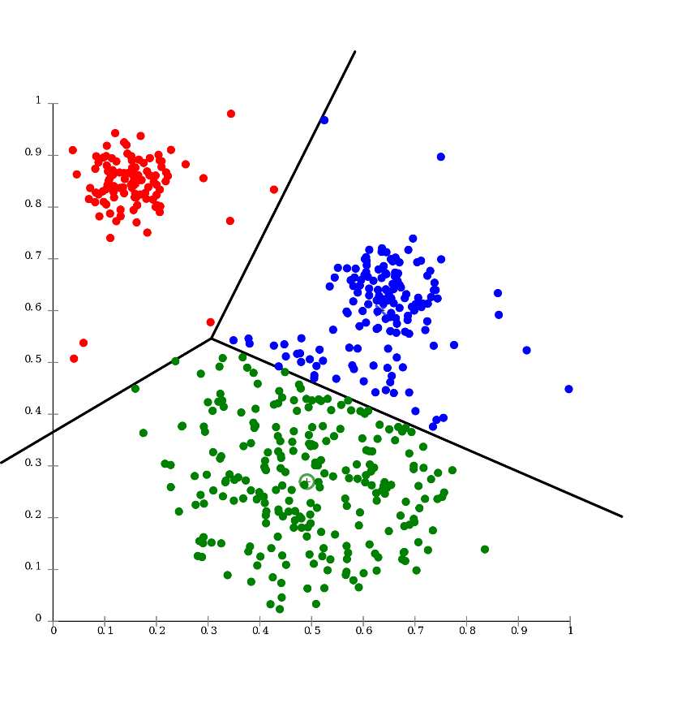

Vs. Unsupervised learning
Flat structure clustering as an example
  Training time
    Input: ${\{x_{n}\}}_{n=1}^{N}$, where $x∈R^{d}$
    Output: hypothesis $g_{θ }\left(x\right)→k$, where $k∈[K]$
    Goal: $\min{\sum_{k=1}^{K}{\sum_{g\left(x_{m}\right)=g\left(x_{n}\right)=k}{L\left(x_{m},x_{n}\right)} }}$
  Testing time
    Apply $g_{θ}\left(x\right)→k$
Your clustering criterion
NO information about the clustering structure at all?!
Source: https://en.wikipedia.org/wiki/Cluster_analysis

Slide 16
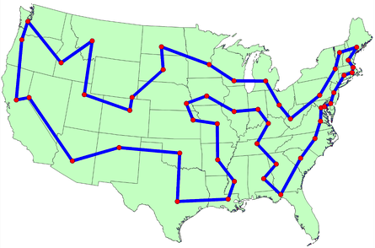
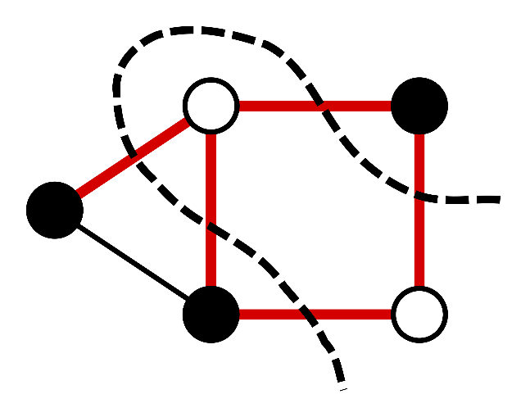
Vs. Combinatorial optimization
Known environment model
  A planning problem in RL
It also becomes a learning problem, when functional approximation is needed.
Traveling salesman problem
Maximum cut

Slide 17
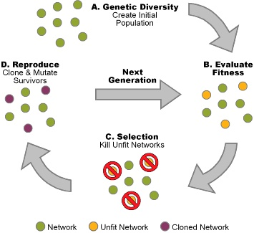
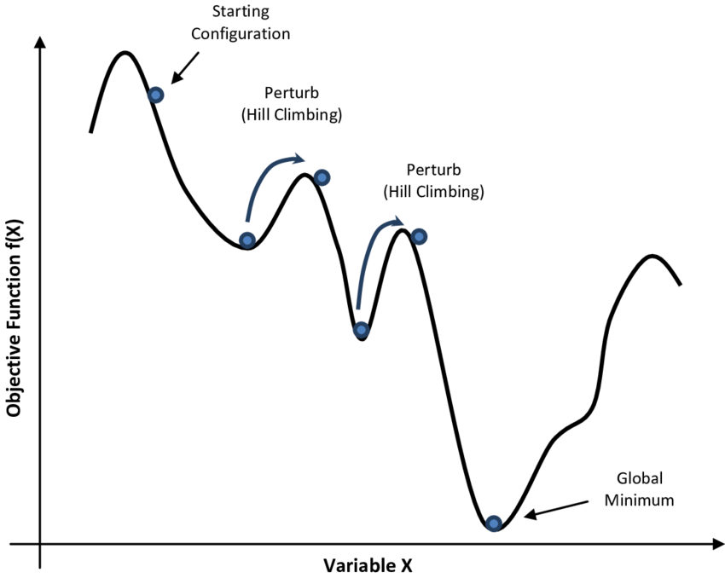
Vs. Evolutionary methods
A family of trial-and-error search solutions
  Over a population of policies
  Fail to leverage detailed problem structure
Policies
Perturb to a different policy
Genetic programming
Simulated annealing

Slide 18
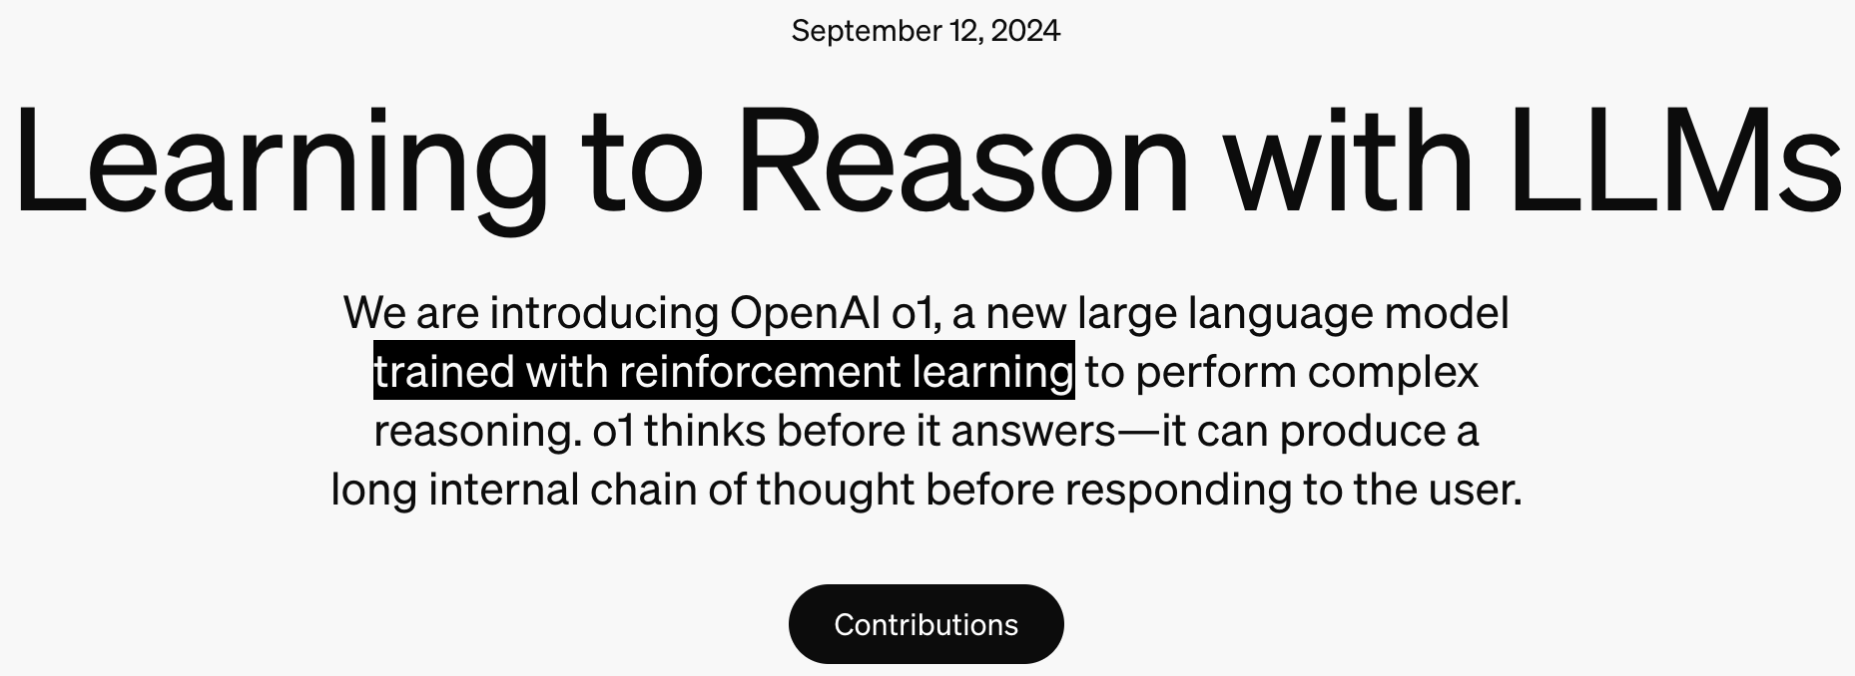
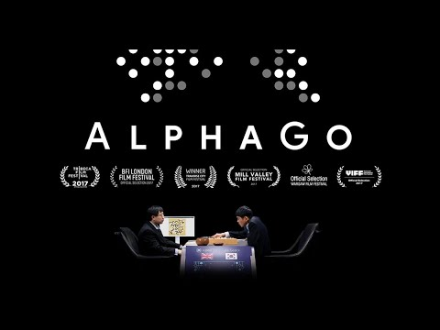
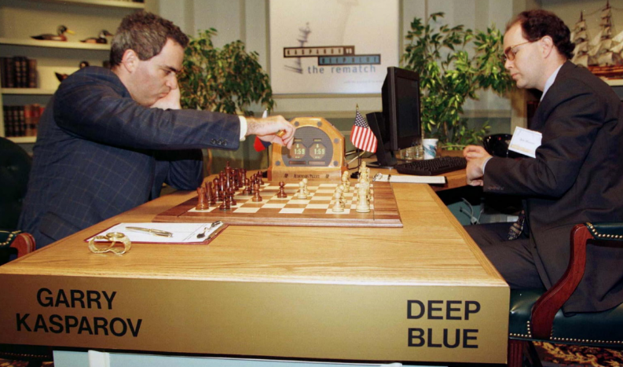
Why reinforcement learning
Sequential decision making is everywhere
2016
1997

Slide 19
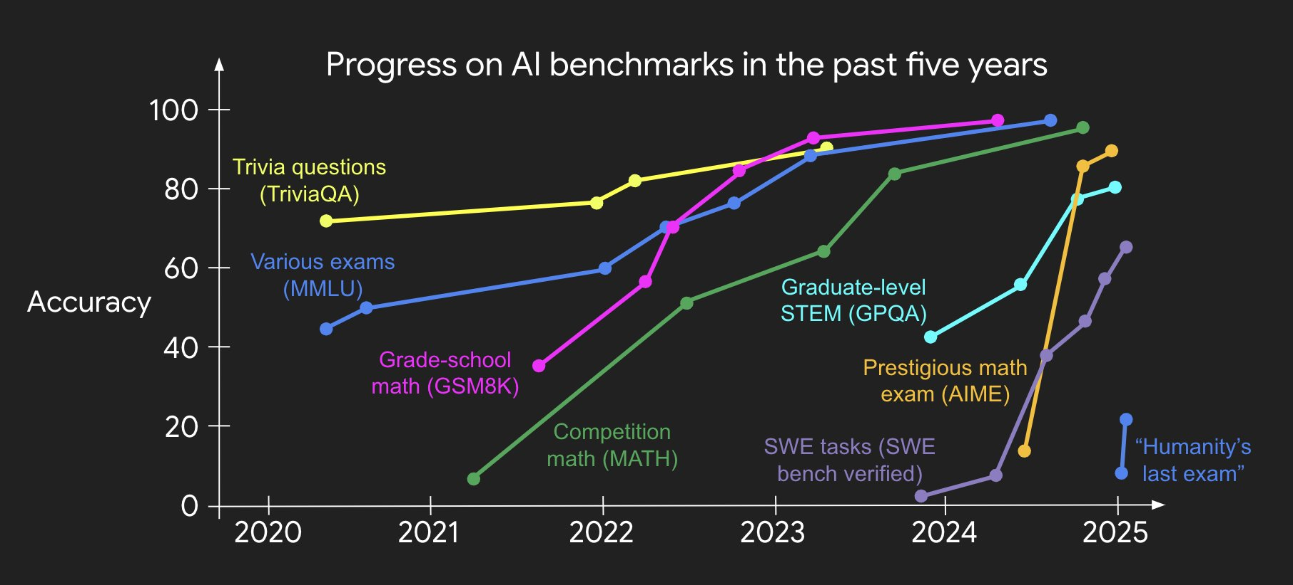
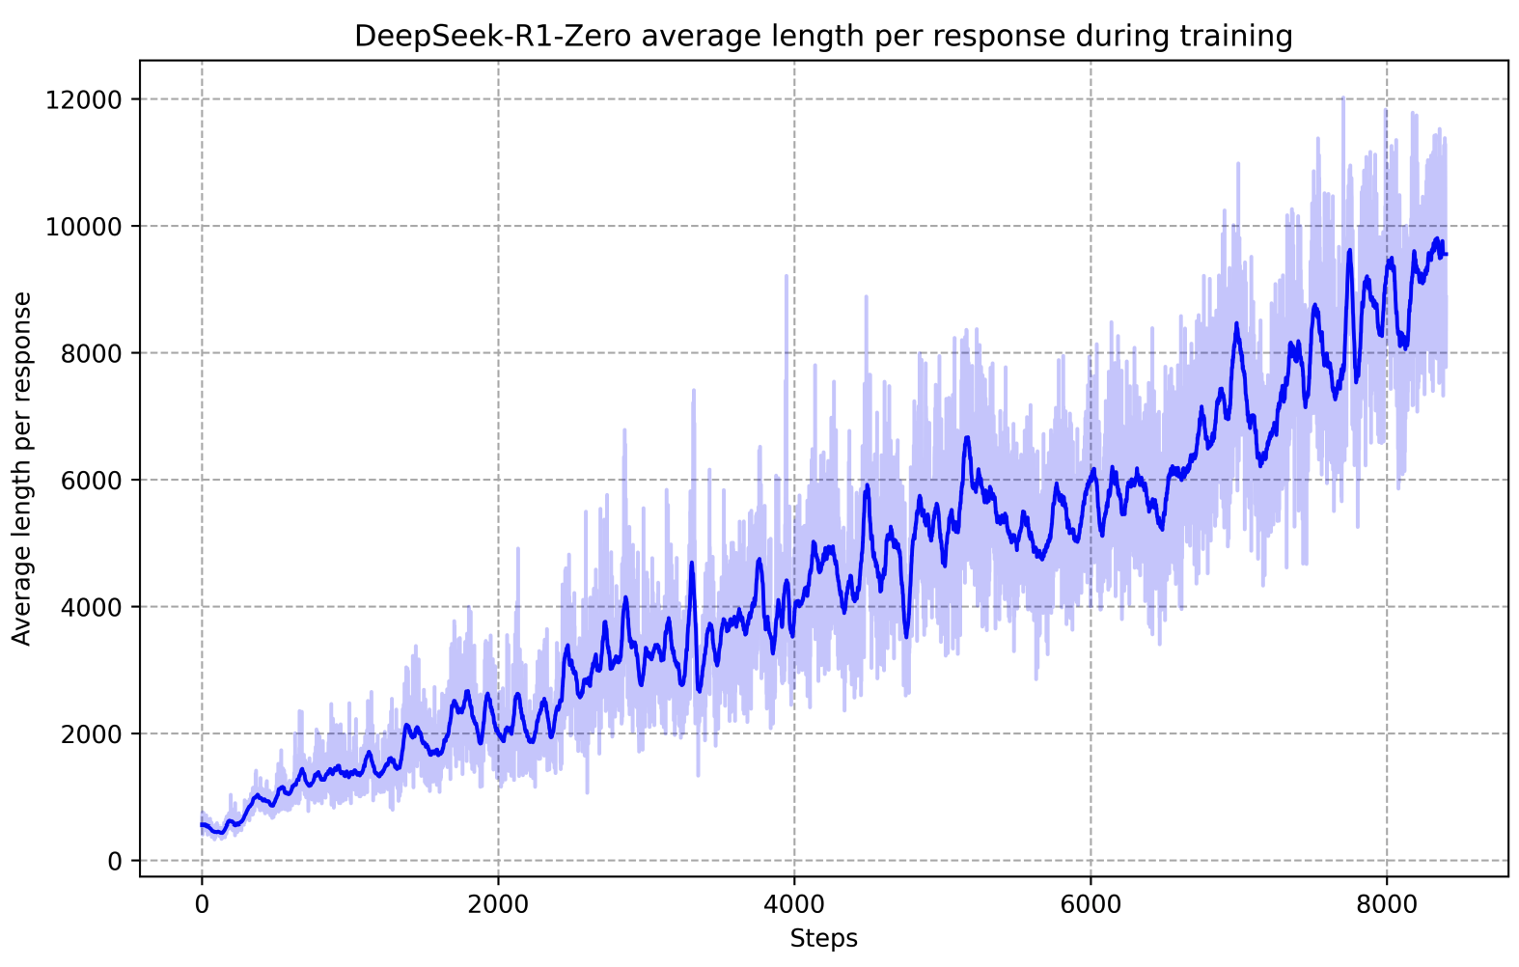
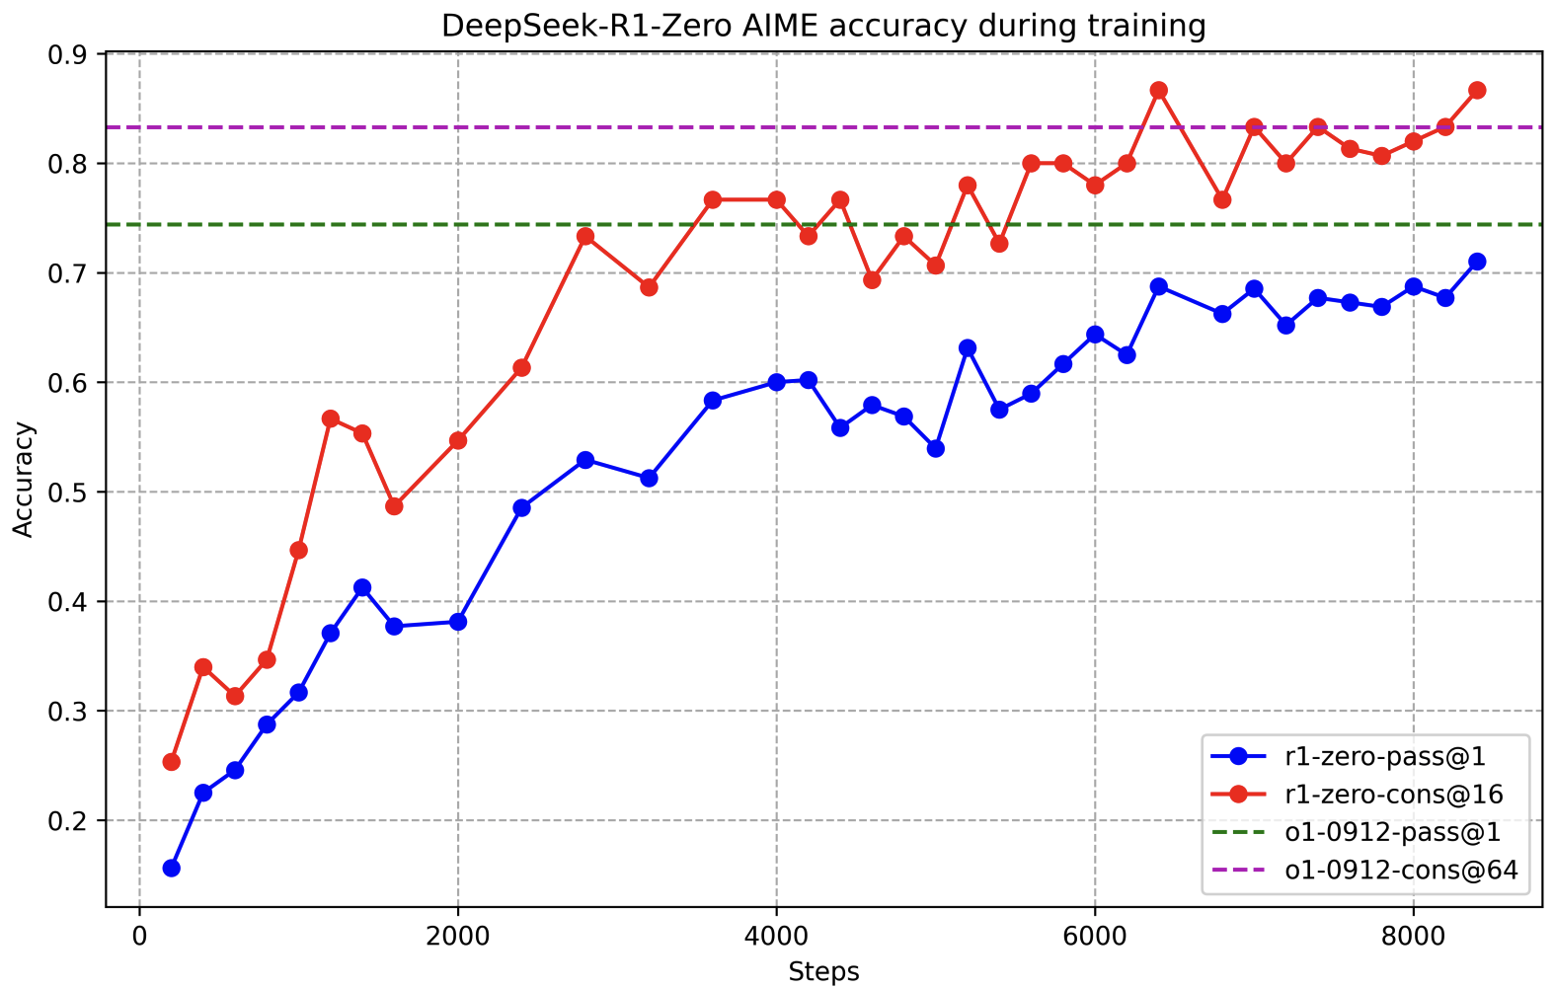
Reinforcement learning in LLMs
Main driving force behind LLMs’ improvements
Long CoT Reasoning
Winnning IOI/IMO golden medals

Slide 20
Recap: reinforcement learning
It is a family of problems
  Sequential decision making
It is a family of solutions
  Planning and learning
It is a collection of fields that study the problems and solutions

Slide 21
Recap: comparisons
Reinforcement learning
  Reward
  Partial information
  Delayed consequence
  Agent’s choice affects the subsequent data it receives, i.e., non-i.i.d.
Supervised machine learning
  Ground-truth labels
  Full information
  Immediate consequence
  Pre-determined data distribution, i.e., i.i.d.

Slide 22
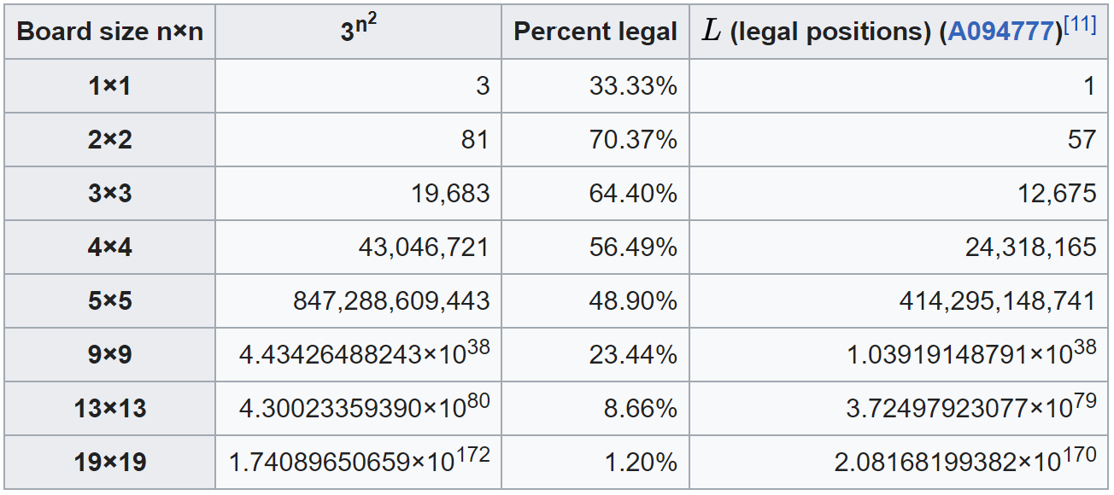

Why reinforcement learning
Sequential decision making is challenging
  Huge search space
Source: https://en.wikipedia.org/wiki/Go_and_mathematics
Complexity: ${10}^{50}$

Slide 23

Why reinforcement learning
Sequential decision making is challenging
  Huge unknown search space
Horror
Romance
Drama

Slide 24
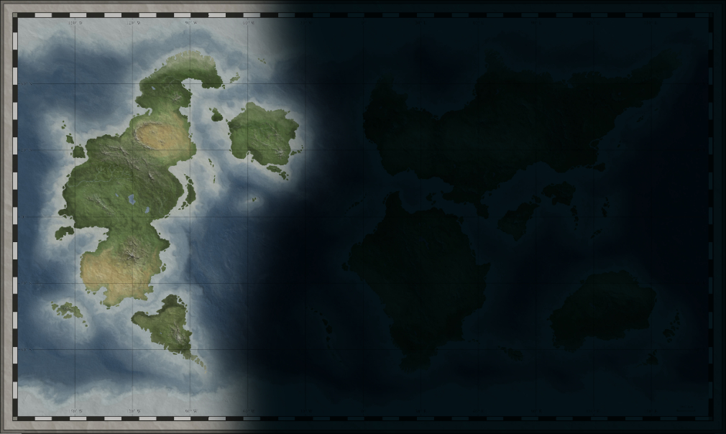
Why reinforcement learning
Sequential decision making is challenging
  Huge unknown search space
    Supervised ML: generalize to unseen
    RL: what to generalize

Slide 25
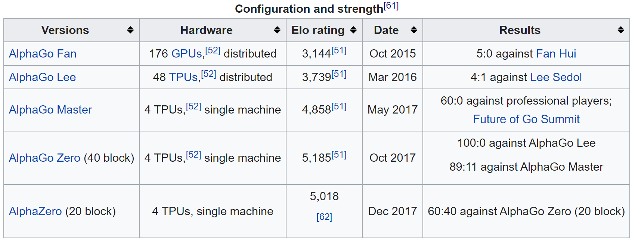
Why reinforcement learning now
Computational model
  Deep learning enables sophisticated functional approximation
Computational power
The system derived its playing strength mainly from brute force computing power. It was a massively parallel, RS/6000 SP Thin P2SC-based system with 30 nodes, with each node containing a 120 MHz P2SC microprocessor enhanced with 480 special purpose VLSI chess chips.
Source: https://en.wikipedia.org/wiki/Deep_Blue_(chess_computer)
Deep Q-net + Monte Carlo Tree Search
alpha-beta search
Source: https://en.wikipedia.org/wiki/AlphaGo

Slide 26
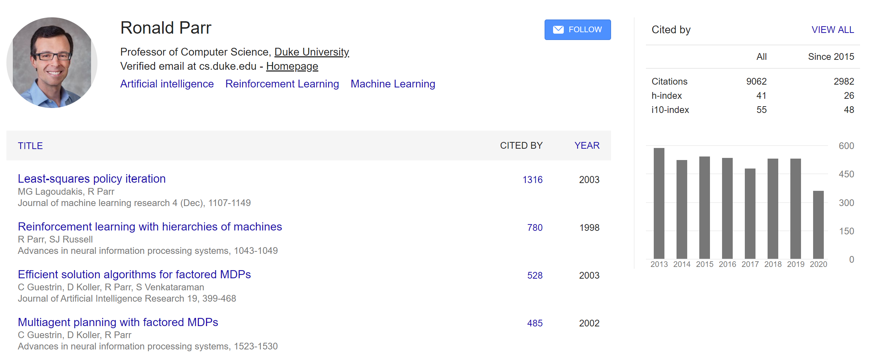
Why reinforcement learning now
Low hanging fruits in other machine learning fields have been plucked
  An argument by Prof. Ronald Parr ☺
The development in other machine learning fields prepared us
  Optimization, especially online stochastic optimization
  Deep learning
Demand from practice, especially industry
  Robotics
  Large language models

Slide 27

How to do reinforcement learning
Dijkstra's algorithm:
With a known environment
  Planning - a classical AI search problem
$$Θ(\left(\left|V\right|+\left|E\right|\right)\log{|V|} )$$
2
g
2
1
t
b
d
4
4
2
a
4
9
f
2
c
e
5
3
Planning for the long-term is necessary

Slide 28

How to do reinforcement learning
With a known but stochastic environment
  Planning – value/policy estimation
2
g
2
1
t
b
d
4
This could also be stochastic!
P=0.2
4
2
a
4
9
P=0.5
f
2
P=0.8
P=0.5
c
e
5
3
Example credit: Jiang, UIUC CS-498

Slide 29
How to do reinforcement learning
With an unknown and stochastic environment
  Planning
2
g
2
1
t
b
d
4
P=0.2
4
2
a
4
9
P=0.5
f
2
P=0.8
P=0.5
c
e
5
3
Example credit: Jiang, UIUC CS-498

Slide 30
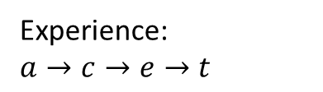
How to do reinforcement learning
With an unknown and stochastic environment
  Planning while learning
    Trial and error
g
t
b
d
a
f
Experience:
$$a→c→e→t$$
2
c
e
5
3
Example credit: Jiang, UIUC CS-498

Slide 31

How to do reinforcement learning
With an unknown and stochastic environment
  Planning while learning
    Trial and error
g
t
b
d
2
a
f
Experience:
$$a→c→e→t$$
$$a→c→e→f→t$$
2
c
e
5
3
Example credit: Jiang, UIUC CS-498

Slide 32
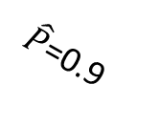
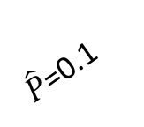


How to do reinforcement learning
With an unknown and stochastic environment
  Planning while learning
    Trial and error
  Model-based
    Experience -> model
Bias v.s., variance?
2
g
2
1
t
b
d
4
$\hat{P}$=0.1
4
2
a
4
9
$\hat{P}$=0.4
f
Convergence of the model matters!
2
$\hat{P}$=0.9
$\hat{P}$=0.6
Experience:
$$a→c→e→t$$
$$a→c→e→f→t$$
e
5
c
3
Example credit: Jiang, UIUC CS-498

Slide 33
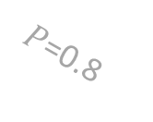

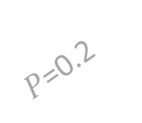



How to do reinforcement learning
With an unknown and stochastic environment
  Planning while learning
    Trial and error
  Model-free
    Experience -> policy
    Experience -> value
How do we get such experiences matters!
I.e., the explore-exploit trade-off; sometimes it is also the bias-variance trade-off
2
g
2
1
t
Up
P=0.3
b
d
4
$$π( )$$
a
$P$=0.2
4
2
a
4
9
Down
P=0.7
$P$=0.4
f
2
$P$=0.8
$\hat{P}$=0.6
9
Up
Experience:
$$a→c→e→t$$
$$a→c→e→f→t$$
e
5
c
$$v( )$$
3
a
Example credit: Jiang, UIUC CS-498
7.6
Down

Slide 34
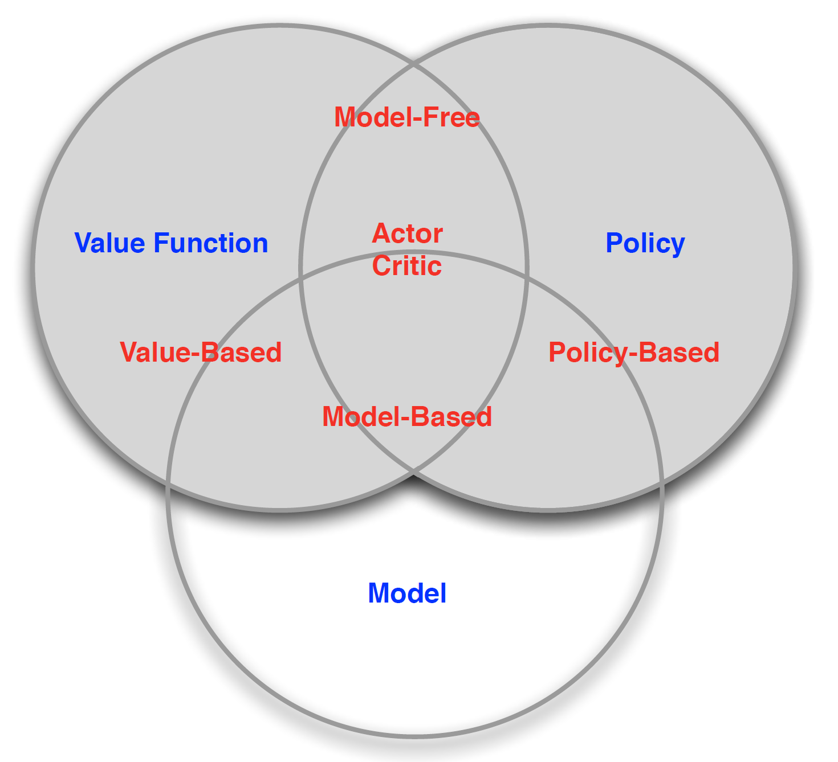
How to do reinforcement learning
With an unknown and stochastic environment
  A taxonomy of solutions
Figure credit: David Silver, “Introduction to RL”

Slide 35
How to do reinforcement learning
A brief history of reinforcement learning research
  Textbook, Chapter 1, Section 1.7
    Planning – originated in optimal control
      Dated back to 1950s
    Reinforcement learning – originated in psychology of animal learning
      Dated back to 1850s

Slide 36
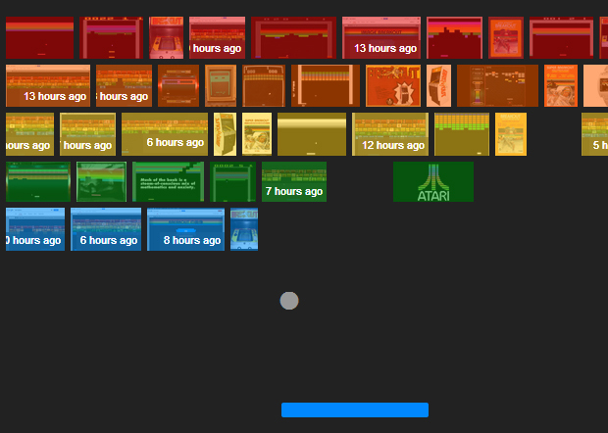
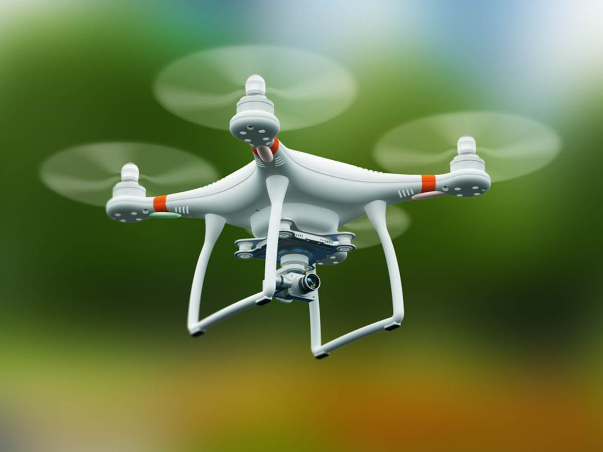
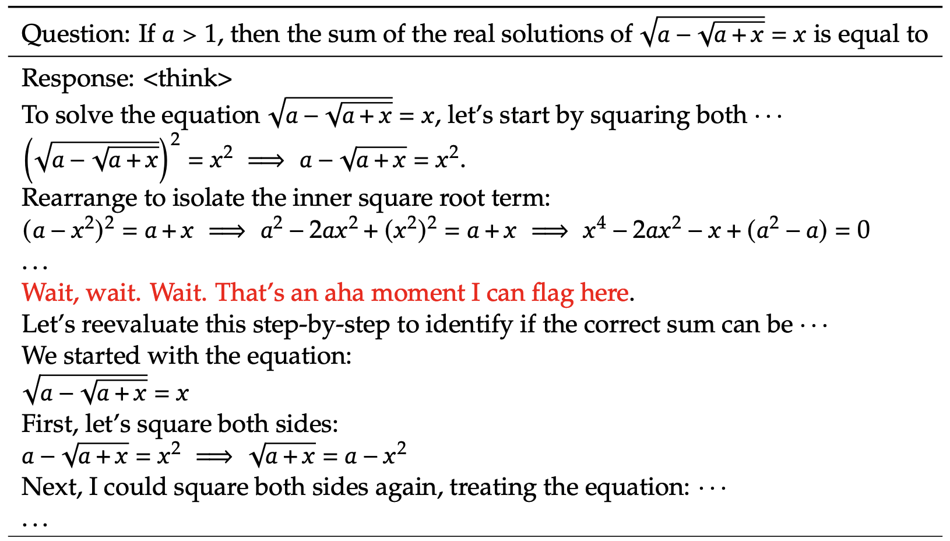
Reinforcement learning in practice is challenging
  Learning by trial and error is expensive
    We need an environment to repeatedly interact with
Environment defined by
game rules
physical rules
mathematical rules
Simulation is easy

Slide 37
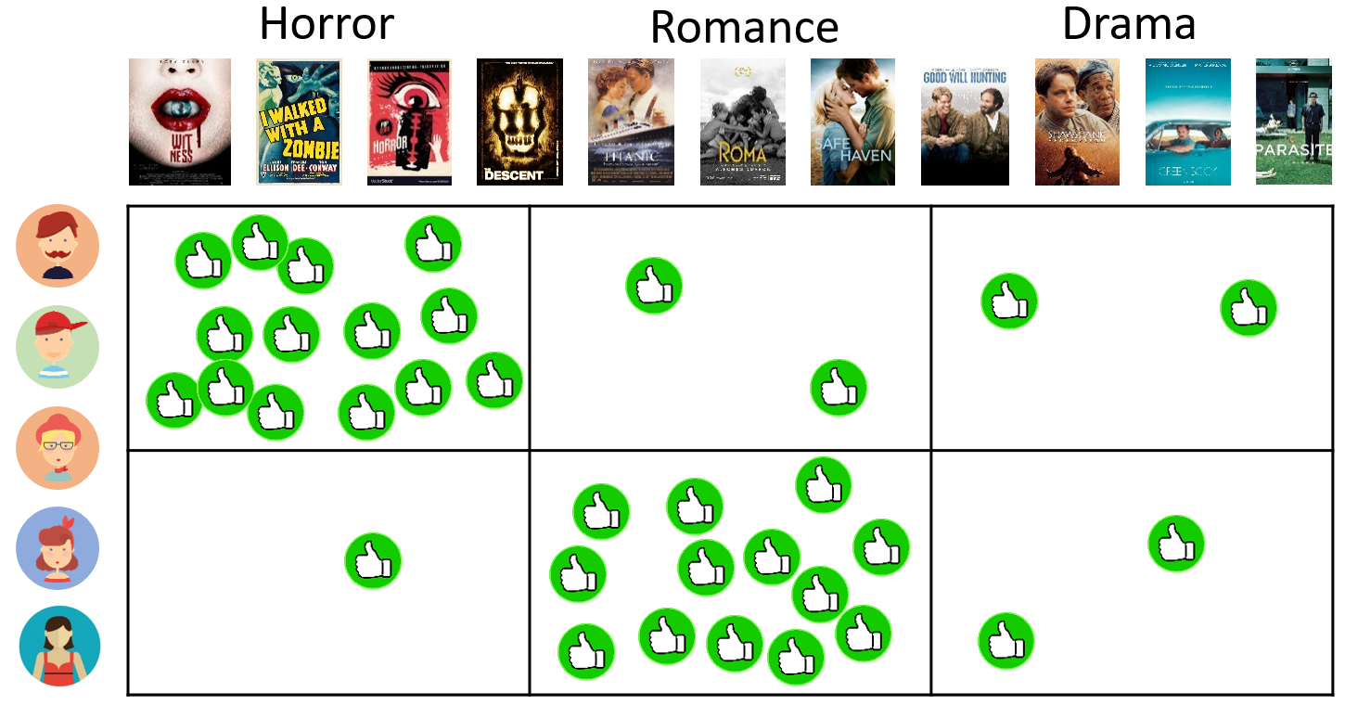
Reinforcement learning in practice is challenging
  Learning by trial and error is expensive
    We need an environment to repeatedly interact with
Environment defined by
Users’ behaviors
Simulation is hard!

Slide 38
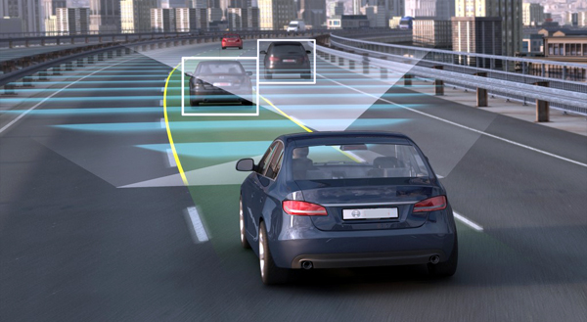
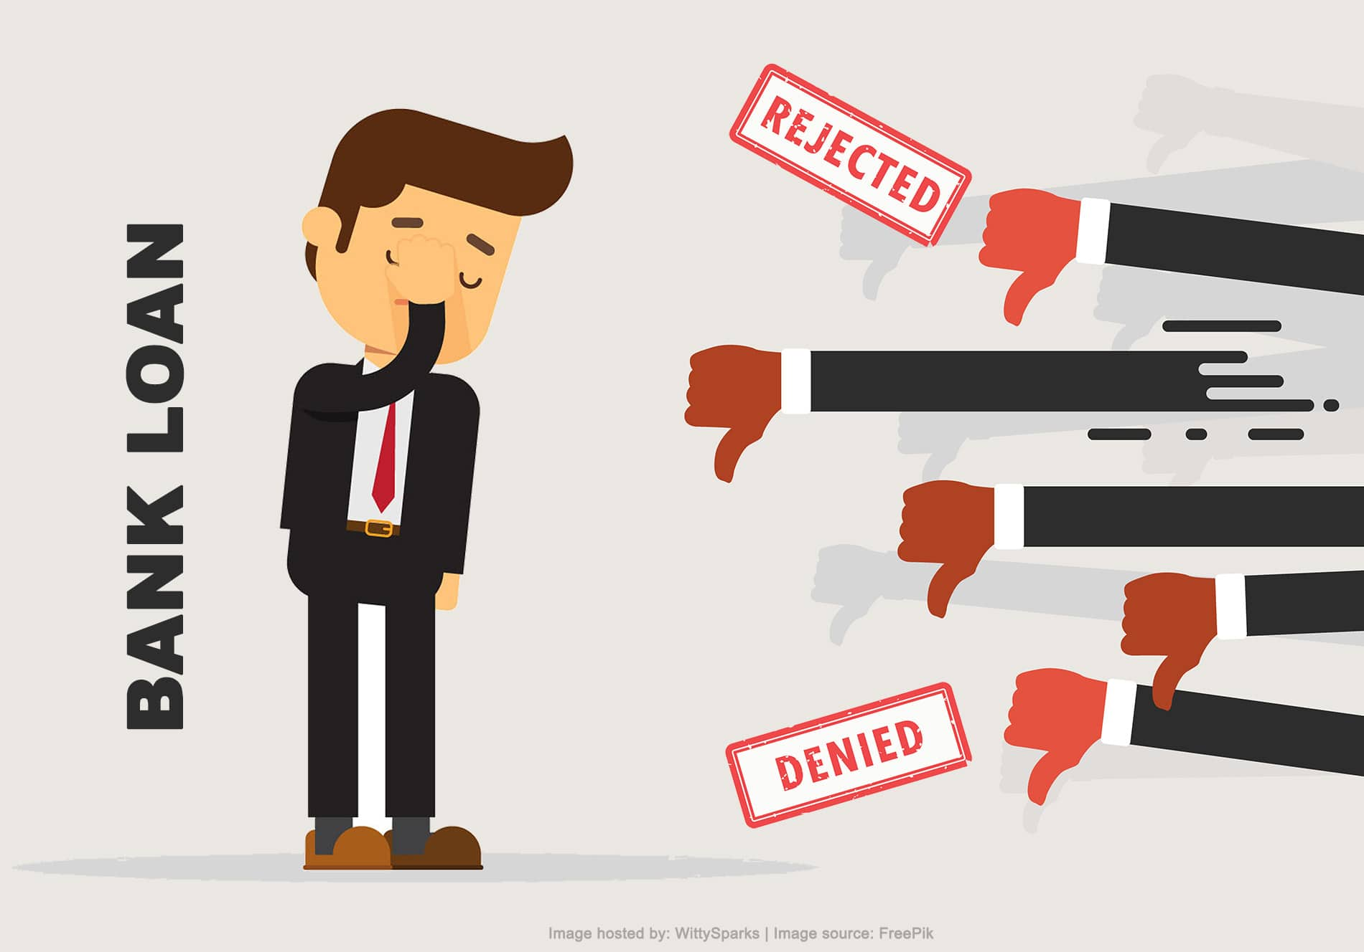
Reinforcement learning in practice is challenging
  There are also safety, privacy, and ethic concerns in exploration
    We are dealing with unknown unknowns
    We are learning from explorations

Slide 39
Takeaways
Reinforcement learning is for sequential decision making
Reinforcement learning overlaps heavily with different machine learning techniques, but also uniquely differs from them
Known environment v.s., unknown environment
Model-based v.s., model-free

Slide 40
References
[SSSCJ16] Schnabel, T., Swaminathan, A., Singh, A., Chandak, N., & Joachims, T. (2016, June). Recommendations as treatments: debiasing learning and evaluation. In Proceedings of the 33rd International Conference on International Conference on Machine Learning-Volume 48 (pp. 1670-1679).
LilLog, https://lilianweng.github.io/lil-log/
David Silver, Advanced Topics 2015 (COMPM050/COMPGI13): Reinforcement Learning, University College London.
Nan Jiang, CS 498 Reinforcement Learning, University of Illinois at Urbana-Champaign.
Bishop, Christopher M. Pattern recognition and machine learning. springer, 2006.

Slide 41
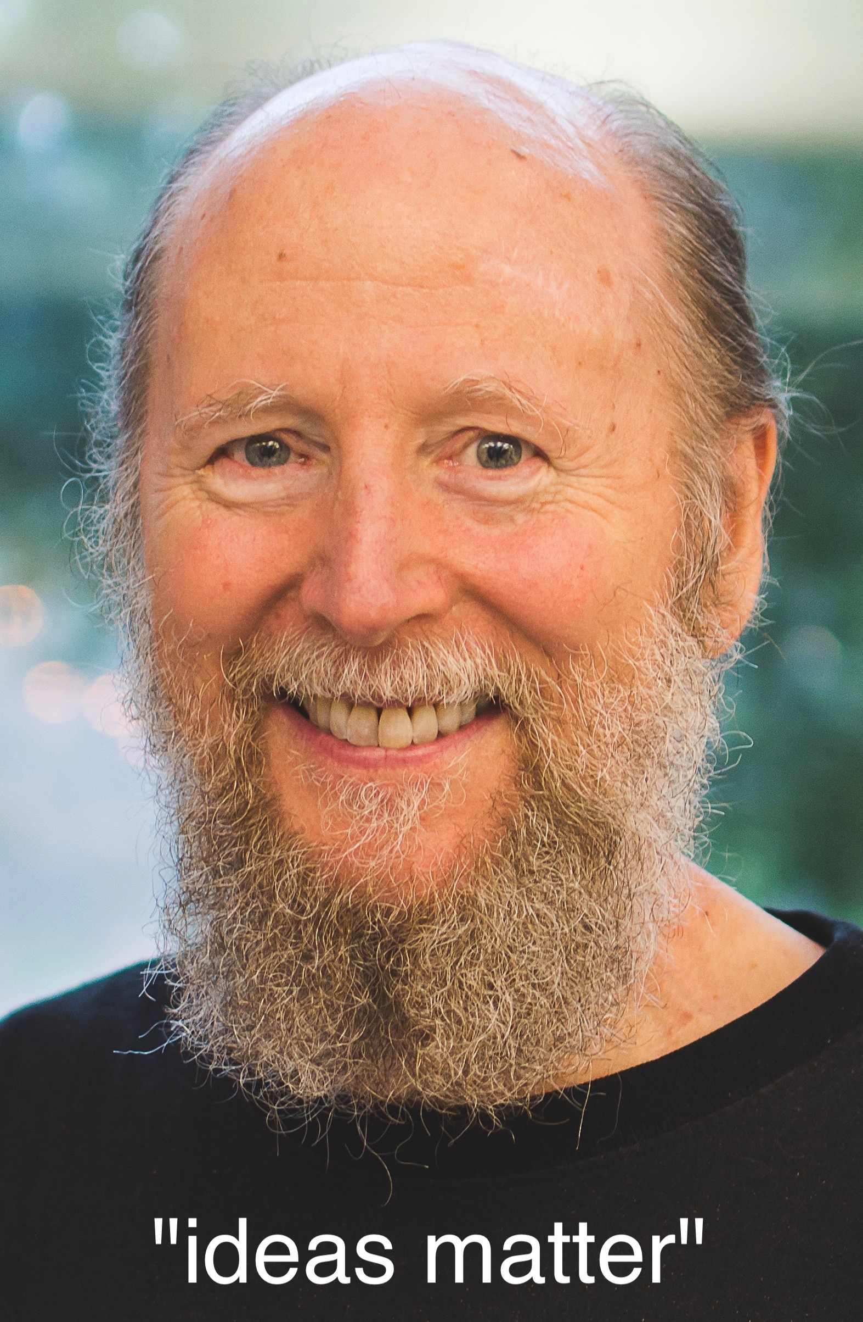
The bitter lesson
1) AI researchers have often tried to build knowledge into their agents,
2) this always helps in the short term, and is personally satisfying to the researcher,
BUT
3) in the long run it plateaus and even inhibits further progress,
4) breakthrough progress eventually arrives by an opposing approach based on scaling computation by search and learning.
- Richard Sutton

